Slide 1

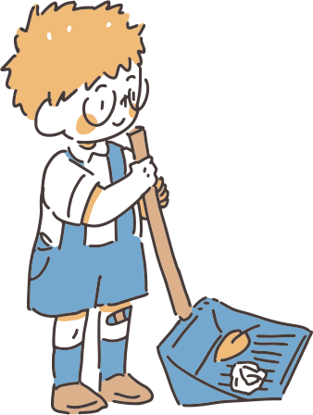

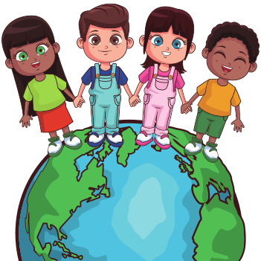
Family Reunification

Slide 2

Meet Our Group
Sanjana Gupta
Shivanjali Kumari
Prashant Kumar MIshra
Akanksha Gupta

Slide 3
Problem
Each year 1.2 million children are trafficked globally.
Children can also go missing from public places such as parks, playgrounds, shopping malls, and other crowded areas
Only a few of them are traced by the government and reunified with their family.
Remaining other gets into the wrong hand and indulge in various crime like drug trafficking, and robbery

Slide 4

STEPS
01
02
03
If any citizen finds any missing child, he can upload the image, location any mark etc.
An algorithm hit if any match is found and email will be sent to parent and near by Police Station.
Parent will upload data of their child and the details like name, age,height,birthmark,and FIR No.

Slide 5
Reunite Missing Children
Raise Awareness
Utilize Face Recognition Technology
project Goals

Slide 6
Tech Stack
Backend
Face Recognition
Django
Face Recognition Library
Frontend
Database
Html
Css
Js
Bootstrap
Sqlite

Slide 7
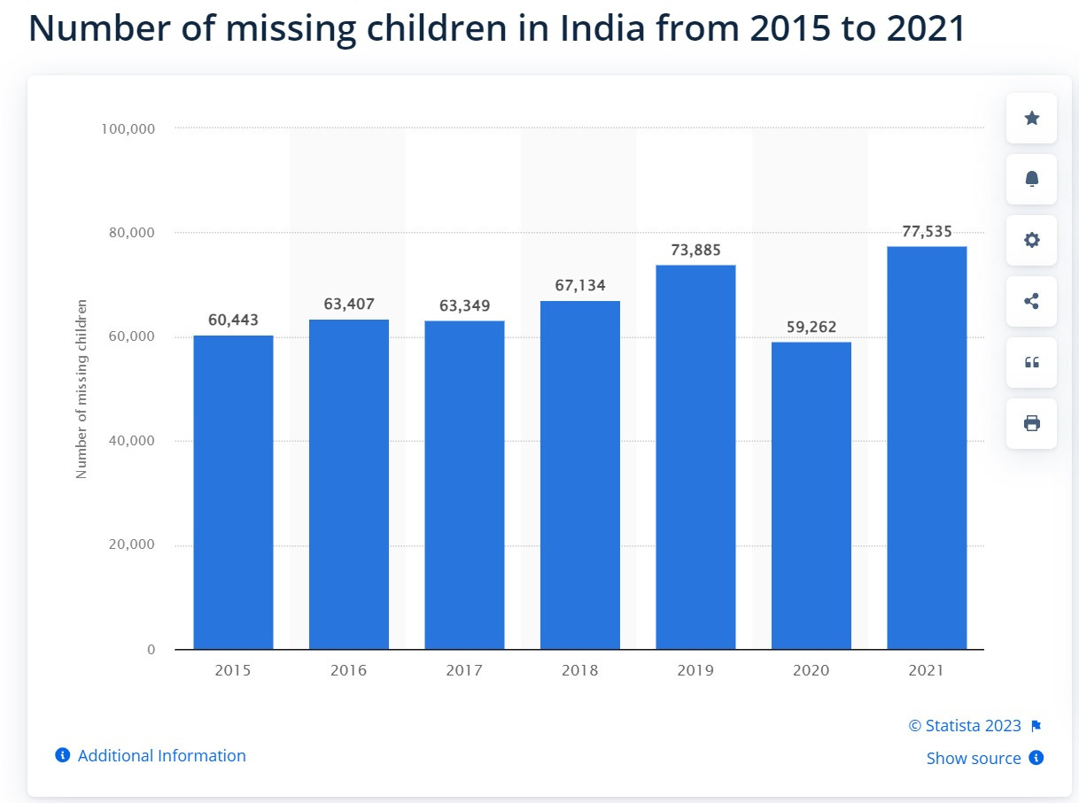
Survey

Slide 8
Future Scope
ML model for Age Progression
Collaboration with NGO’s
Multilingual Support
Geofencing Alerts

Slide 9
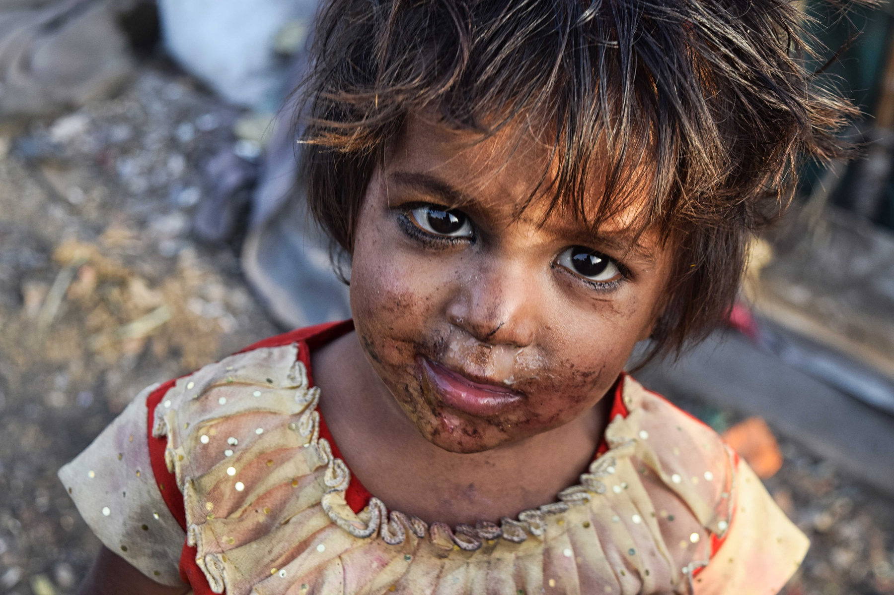
References
https://trackthemissingchild.gov.in/trackchild/index.php
https:/www.childlineindia.org/a/issues/missinghttps:/nhrc.nic.in/sites/default/files/misc_MCRReport.pdf
https:/indianexpress.com/about/missing-children/
https:/www.tandfonline.com/doi/abs/10.1080/08824091003776289

Slide 10
Thank You

